Slide 1
Lucia and the Brain:
The Lucia Model
Compared to Brain Data
Peter Lindes
Soar Workshop
9 May 2019

Slide 2
Agenda
Behavior: Form -> Meaning
Theory #1: Lucia Processing
Predictions
EEG Data
Evidence
Theory #2: Overlapped Processing
Predictive Coding
Evidence
Theory #3: Predictive Processing

Slide 3
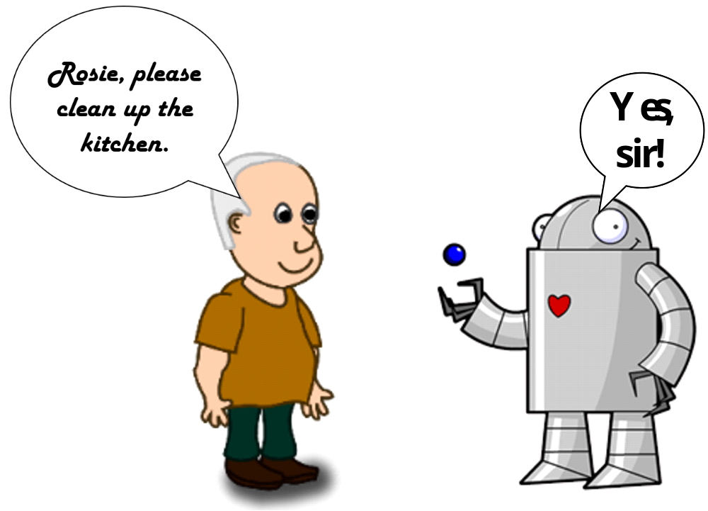
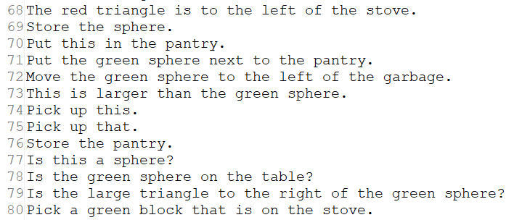
Behavior: Form -> Meaning

Slide 4
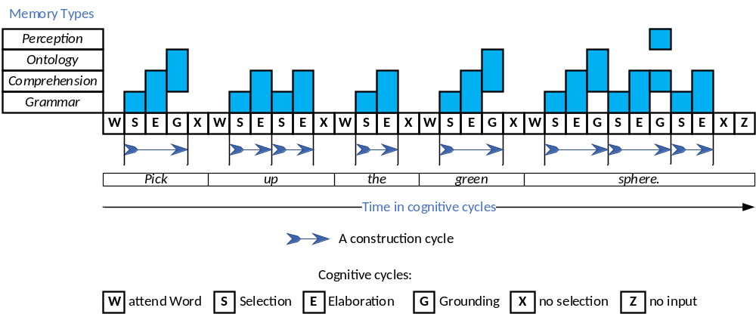
Theory #1: Lucia Processing

Slide 5
Predictions
Words are processed one at a time
Constructions are processed one at a time
Several construction cycles per word
Immediate grounding
A pattern of memory access
Process to completion before starting next word

Slide 6
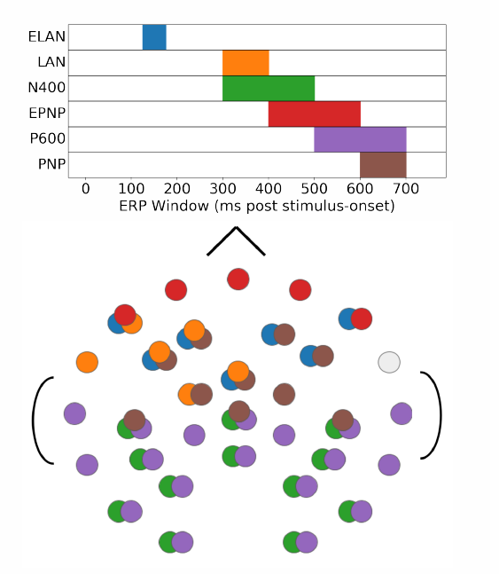
EEG Data
Schwartz, Dan and Tom Mitchell (2019). Understanding language-elicited EEG data by predicting it from a fine-tuned language model. arXiv:1904.01548 [cs.CL]

Slide 7
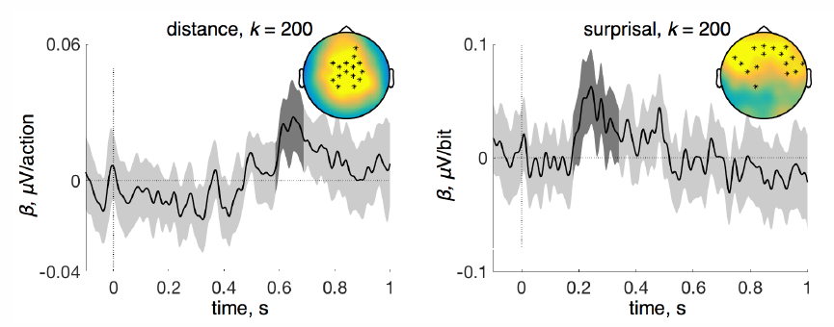
EEG Data
Hale, John, Chris Dyer, Adhiguna Kuncoro, and Jonathan R. Brennan (2018). Finding Syntax in Human Encephalography with Beam Search. Proceedings of the 56th Annual Meeting of the Association for Computational Linguistics (Volume 1: Long Papers). arXiv:1806.04127 [cs.CL]

Slide 8
Evidence
700 to 1,000 ms to process a word fully
Words come in every 200 to 400 ms
Processing of words must overlap
Some kind of a pipeline/cascade

Slide 9

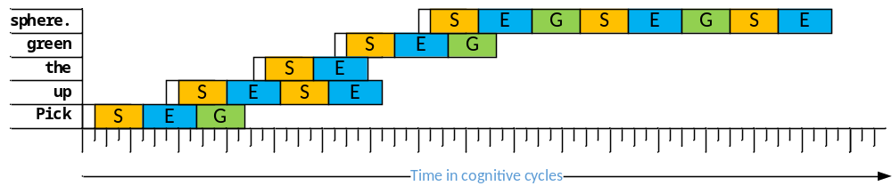
Theory #2 – Overlapped Processing
In processing a sentence, we try to extract as much information as possible from each word and spend some additional wrap-up time at the end of each phrase. John R. Anderson, 1995, p. 385.

Slide 10
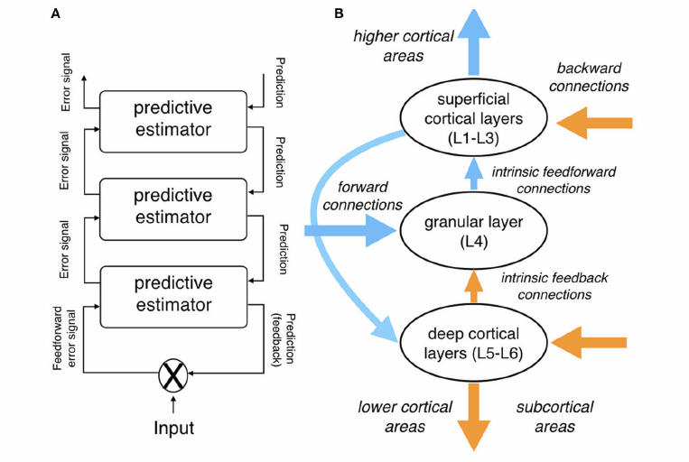
Predictive Coding
Bornkessel-Schesewsky, Ina and Matthias Schlesewsky (2019). Toward a Neurobiologically Plausible Model of Language-Related, Negative Event-Related Potentials. Frontiers in Psychology 10. doi:10.3389/fpsyg.2019.00298

Slide 11
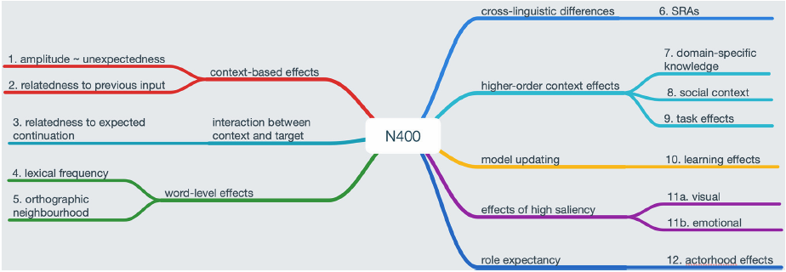
Predictive Coding and Language
Bornkessel-Schesewsky, Ina and Matthias Schlesewsky (2019). Toward a Neurobiologically Plausible Model of Language-Related, Negative Event-Related Potentials. Frontiers in Psychology 10. doi:10.3389/fpsyg.2019.00298

Slide 12
Evidence
The brain makes predictions
Top-down AND bottom-up information flow
Error measured at each abstraction layer
Large errors cause model updates

Slide 13
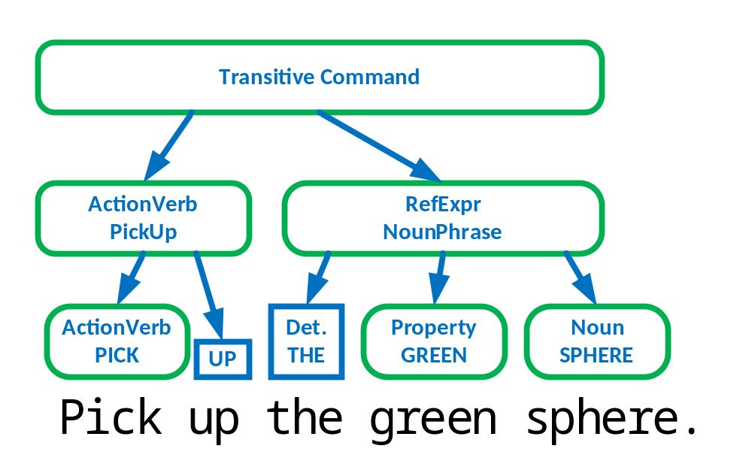
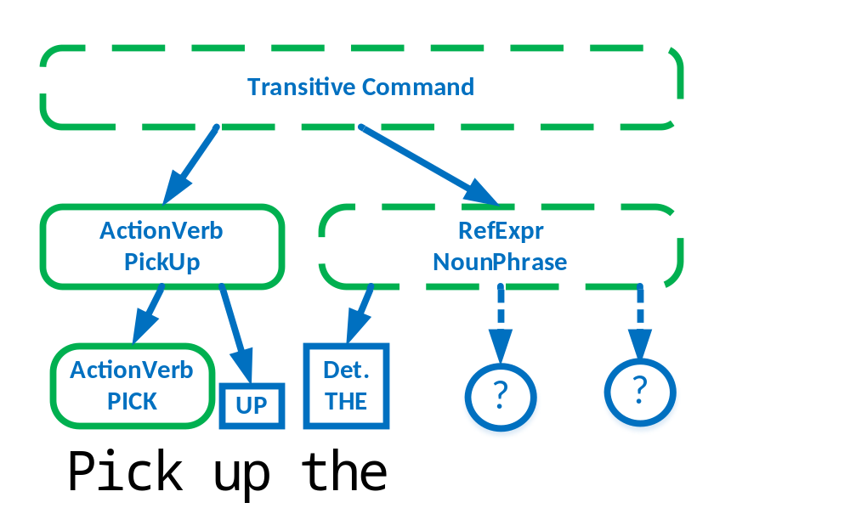
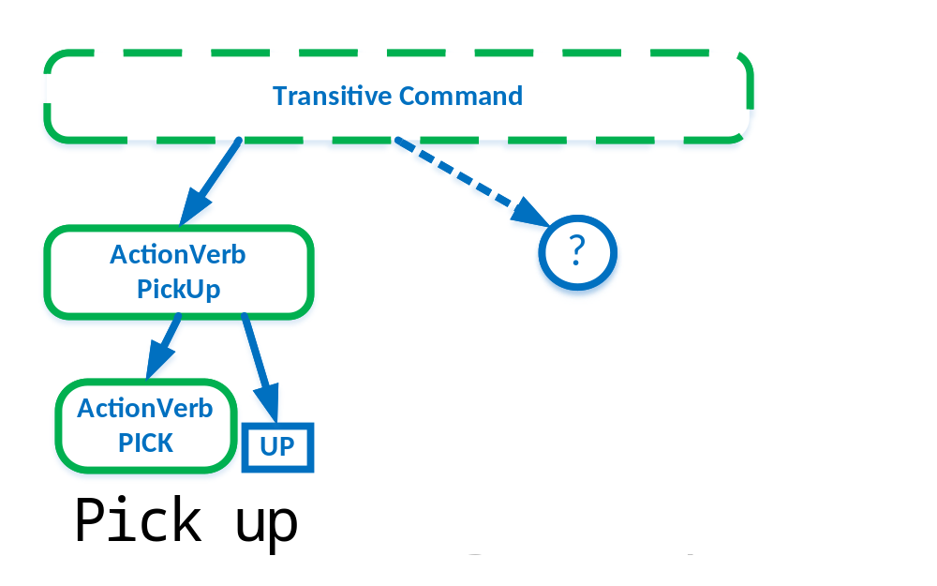
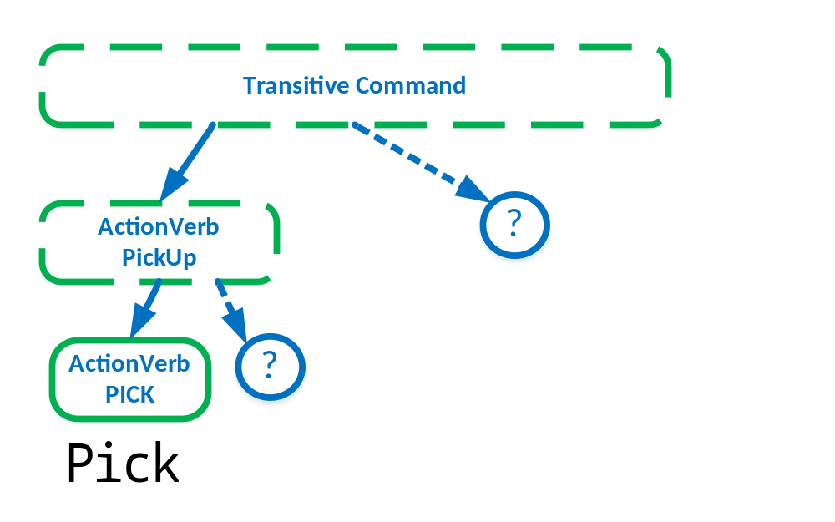
Theory #3: Predictive Processing

Slide 14

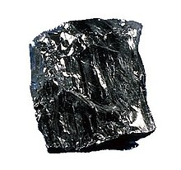
How do humans comprehend language?
Behavior
  Form -> Meaning
  Learn in increments
Processing
  Incremental
  Immediate interpretation
Physical mechanisms
  The brain

